Slide 1
UPPER SIXTH ARTS
GEOGRAPHY
Lesson 14
Urban Fields (Spheres of Influence)
Notes:
Good morning, class, and welcome to our geography lesson. I am your geography teacher, Mr Kamdem. Today we are starting Lesson 14: Urban Fields (Spheres of Influence).

Slide 2
CLASS INFO
Class, Chapter and Duration
Class | Upper Sixth Arts
Chapter | Module 5: Understanding and managing settlement dynamics across the world in general and Cameroon in particular
Duration | 2 periods (2 × 50 minutes)
Notes:
This lesson is for Upper Sixth Arts. It belongs to Module 5: Understanding and managing settlement dynamics across the world in general and Cameroon in particular. We shall need 2 periods to cover it.

Slide 3
IDENTIFICATION
Lesson Identification
Topic | Urban Hierarchy
Sub-topic | Urban Growth
Lesson | Lesson 14: Urban Fields (Spheres of Influence)
Notions / Concepts | Urban field, sphere of influence, hinterland, breaking point.
Syllabus focus | Meaning; shapes and sizes of urban fields; factors.
Competence | Learners are able to describe and explain the urban fields of towns.
Notes:
Our topic is Urban Hierarchy, and the sub-topic is Urban Growth. The key notions we shall use today are: urban field, sphere of influence, hinterland, breaking point. At the end, you should be able to do this: learners are able to describe and explain the urban fields of towns.

Slide 4

HOMEWORK CORRECTION
Correction of the Homework
Question (Lesson 13: Urban Regions: Millionaire Cities, Conurbations and Megalopolis):
Name five megacities and mark them on a world map.
Notes:
Before we start the new lesson, let us correct the homework I gave you at the end of Lesson 13: Urban Regions: Millionaire Cities, Conurbations and Megalopolis. The question was: Name five megacities and mark them on a world map. Take out your exercise books.

Slide 5
HOMEWORK CORRECTION
Correction: Possible Answer
Examples: Tokyo (Japan), Delhi (India), Shanghai (China), São Paulo (Brazil), Lagos (Nigeria), marked on a world map.
Notes:
Here is a good answer. Examples: Tokyo (Japan), Delhi (India), Shanghai (China), São Paulo (Brazil), Lagos (Nigeria), marked on a world map. Compare it with your own answer and correct your work in red.

Slide 6
LESSON PLAN
Lesson Plan
Correction of the homework
Objectives and recall
Real-life situation and action to take
Learning activities
Board summary
Evaluation, remediation and homework
Notes:
Here is the plan of our lesson today. First, we shall correct the homework. Then we shall look at the objectives and recall what you already know. After that, we shall study a situation from real life and the action to take, and do the learning activities. Finally, we shall copy the board summary, do the evaluation and the remediation, and I will give you the homework.

Slide 7
OBJECTIVES
Objectives
By the end of this lesson, you should be able to:
Define an urban field.
Describe the shapes and sizes of urban fields.
Explain the factors of urban fields.
Notes:
By the end of this lesson, you should be able to do three things. Number 1: define an urban field. Number 2: describe the shapes and sizes of urban fields. Number 3: explain the factors of urban fields.

Slide 8
PREVIOUS KNOWLEDGE
Previous Knowledge
Towns provide services to villages.
Big towns interact more (gravity model).
Notes:
Let us first remember what you already know. Towns provide services to villages. Big towns interact more (gravity model). Keep this in mind, because we shall build on it today.

Slide 9
REAL-LIFE SITUATION
Situation in Real Life
People from villages around Dschang come to its market every week, but for a university they go to Dschang, while for a specialist hospital many travel to Yaoundé or Douala.
Notes:
Listen carefully to this situation from real life. People from villages around Dschang come to its market every week, but for a university they go to Dschang, while for a specialist hospital many travel to Yaoundé or Douala. Think about it, because I am going to ask you some questions.

Slide 10
REAL-LIFE SITUATION
Situation: Question 1
What is the problem in the situation?
Notes:
Question 1: What is the problem in the situation? Think for a moment, then raise your hand to answer.

Slide 11
REAL-LIFE SITUATION
Answer
Towns serve areas of different sizes.
Notes:
Good. Towns serve areas of different sizes.

Slide 12
REAL-LIFE SITUATION
Situation: Question 2
What is the area served by a town called?
Notes:
Question 2: What is the area served by a town called? Think for a moment, then raise your hand to answer.

Slide 13
REAL-LIFE SITUATION
Answer
Its urban field (sphere of influence).
Notes:
Good. Its urban field (sphere of influence).

Slide 14
REAL-LIFE SITUATION
Situation: Question 3
Why do people go to Yaoundé for a hospital?
Notes:
Question 3: Why do people go to Yaoundé for a hospital? Think for a moment, then raise your hand to answer.

Slide 15
REAL-LIFE SITUATION
Possible Answer
Specialist services are found only in big cities.
Notes:
Good. Specialist services are found only in big cities.

Slide 16
ACTION TO TAKE
Action to Take
Delimit the zones served by towns to plan services.
Notes:
From this situation, the action we are working towards in this lesson is the following: delimit the zones served by towns to plan services.

Slide 17
JUSTIFICATION
Justification of the Lesson
This lesson helps us to understand the links between towns and their surrounding areas.
Notes:
Why is this lesson important for you? This lesson helps us to understand the links between towns and their surrounding areas.

Slide 18
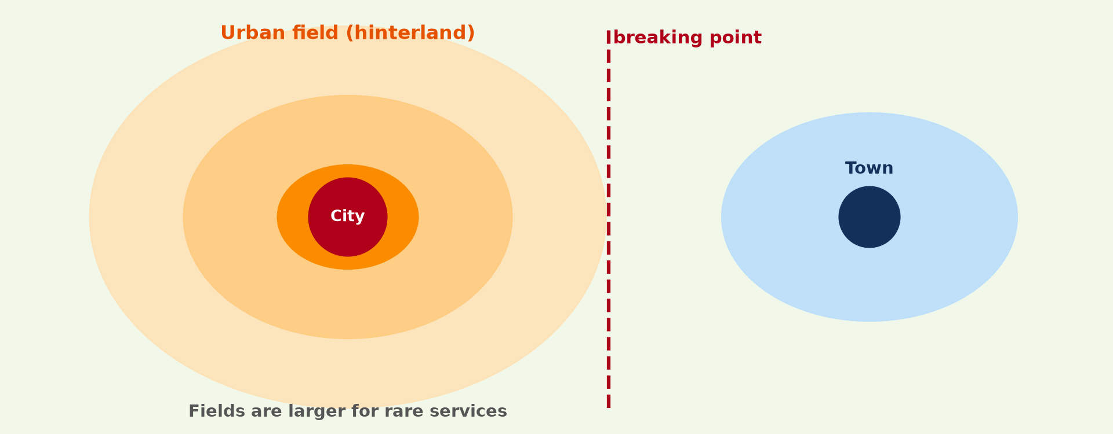
1. MEANING
Activity 1
The urban field of a city.
Notes:
Activity 1. Look carefully at this diagram: the urban field of a city. Observe every detail before I ask the question.

Slide 19
1. MEANING
Activity 1: Question
What is an urban field?
Notes:
Here is the question for Activity 1: What is an urban field? Take one minute to think and write your answer in your rough notebook.

Slide 20
1. MEANING
Activity 1: Answer
The area around a town that depends on it for services and jobs.
Notes:
Let us check the answer together. The area around a town that depends on it for services and jobs.

Slide 21

2. SIZES
Activity 2
Low- and high-order services.
Notes:
Activity 2. Look carefully at this diagram: low- and high-order services. Observe every detail before I ask the question.

Slide 22
2. SIZES
Activity 2: Question
Why is the field for a hospital larger than for a bakery?
Notes:
Here is the question for Activity 2: Why is the field for a hospital larger than for a bakery? Take one minute to think and write your answer in your rough notebook.

Slide 23
2. SIZES
Activity 2: Answer
People travel further for rare, high-order services.
Notes:
Let us check the answer together. People travel further for rare, high-order services.

Slide 24

2. SHAPES
Activity 3
A railway line.
Notes:
Activity 3. Look carefully at this picture: a railway line. Observe every detail before I ask the question.

Slide 25
2. SHAPES
Activity 3: Question
Why are urban fields often stretched along roads and railways?
Notes:
Here is the question for Activity 3: Why are urban fields often stretched along roads and railways? Take one minute to think and write your answer in your rough notebook.

Slide 26
2. SHAPES
Activity 3: Answer
Transport makes it easier to reach the town along those routes.
Notes:
Let us check the answer together. Transport makes it easier to reach the town along those routes.

Slide 27

3. FACTORS
Activity 4
Yaoundé.
Notes:
Activity 4. Look carefully at this picture: yaoundé. Observe every detail before I ask the question.

Slide 28
3. FACTORS
Activity 4: Question
Give three factors of the size of an urban field.
Notes:
Here is the question for Activity 4: Give three factors of the size of an urban field. Take one minute to think and write your answer in your rough notebook.

Slide 29
3. FACTORS
Activity 4: Answer
Size of the town, number of services and transport (also competing towns).
Notes:
Let us check the answer together. Size of the town, number of services and transport (also competing towns).

Slide 30
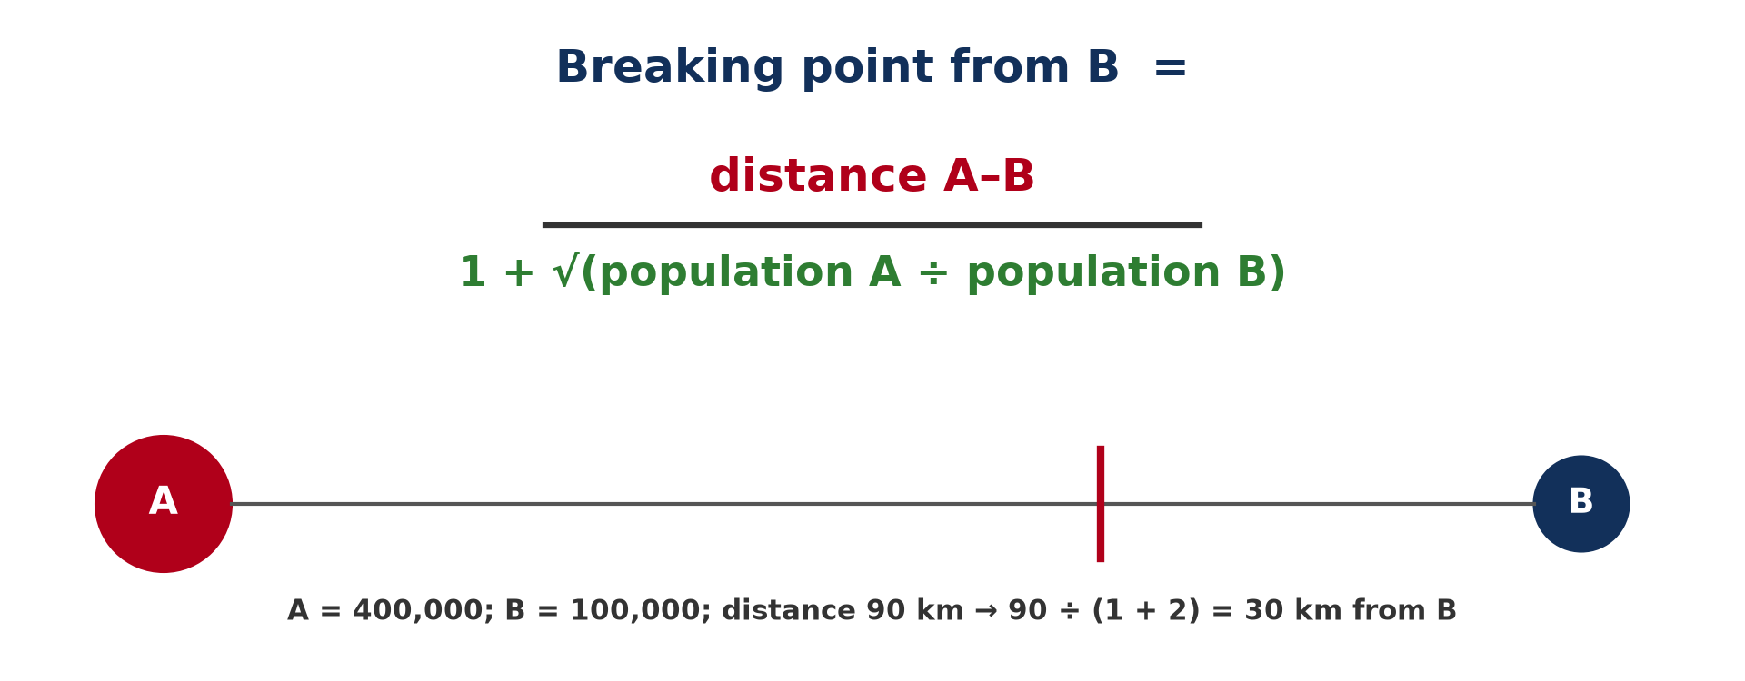
3. FACTORS: COMPETITION
Activity 5
The breaking point between two towns.
Notes:
Activity 5. Look carefully at this diagram: the breaking point between two towns. Observe every detail before I ask the question.

Slide 31
3. FACTORS: COMPETITION
Activity 5: Question
Where is the breaking point between two towns?
Notes:
Here is the question for Activity 5: Where is the breaking point between two towns? Take one minute to think and write your answer in your rough notebook.

Slide 32
3. FACTORS: COMPETITION
Activity 5: Answer
Where their fields meet; closer to the smaller town.
Notes:
Let us check the answer together. Where their fields meet; closer to the smaller town.

Slide 33
BOARD SUMMARY
Board Summary
Topic: Urban Hierarchy
Sub-topic: Urban Growth
Lesson 14: Urban Fields (Spheres of Influence)
Notes:
Now we are going to copy the board summary. Write the title and the headings neatly in your notebooks. I will give you enough time for each slide, so do not rush.

Slide 34
BOARD SUMMARY
1. Meaning of Urban Field
An urban field can be understood as follows:
Urban field (sphere of influence): It is the area around a town that is served by it and depends on it for goods, services and jobs.
Notes:
Let us copy Meaning of Urban Field. An urban field can be understood as follows. On this slide we have Urban field (sphere of influence). Write each point on a new line, with the key term first, and explain it in your own words when we revise.

Slide 35
BOARD SUMMARY
1. Meaning of Urban Field
Illustration: an urban field
Notes:
Now draw this illustration in your notebook: an urban field. Give it a title and label it clearly.

Slide 36
BOARD SUMMARY
2. Shapes and Sizes
Urban fields vary in shape and size:
Sizes: Each service has its own field: high-order services (hospitals, universities) have large fields and low-order services (bakeries) small ones. Large towns have larger fields.
Notes:
Let us copy Shapes and Sizes. Urban fields vary in shape and size. On this slide we have Sizes. Write each point on a new line, with the key term first, and explain it in your own words when we revise. When you finish, we go to the next slide.

Slide 37
BOARD SUMMARY
2. Shapes and Sizes (continued)
Shapes: Fields are rarely circular; they stretch along roads and railways. Relief, rivers and borders cut them.
Notes:
We continue with Shapes and Sizes. On this slide we have Shapes. Write each point on a new line, with the key term first, and explain it in your own words when we revise.

Slide 38
BOARD SUMMARY
3. Factors of Urban Fields
The size and shape of fields depend on:
Size and functions of the town: Towns with more and higher-order services attract people from further away. Yaoundé serves the whole Centre region and beyond.
Notes:
Let us copy Factors of Urban Fields. The size and shape of fields depend on. On this slide we have Size and functions of the town. Write each point on a new line, with the key term first, and explain it in your own words when we revise. When you finish, we go to the next slide.

Slide 39
BOARD SUMMARY
3. Factors of Urban Fields (continued)
Transport and competition: Good roads extend fields, while nearby competing towns limit them. The breaking point between two towns can be found with Reilly's law.
Notes:
We continue with Factors of Urban Fields. On this slide we have Transport and competition. Write each point on a new line, with the key term first, and explain it in your own words when we revise. When you finish, we go to the next slide.

Slide 40
BOARD SUMMARY
3. Factors of Urban Fields (continued)
Physical and political factors: Mountains, rivers and borders limit fields. Administrative boundaries also influence where people go.
Notes:
We continue with Factors of Urban Fields. On this slide we have Physical and political factors. Write each point on a new line, with the key term first, and explain it in your own words when we revise.

Slide 41
BOARD SUMMARY
3. Factors of Urban Fields
Illustration: competition between towns
Notes:
Now draw this illustration in your notebook: competition between towns. Give it a title and label it clearly.

Slide 42
FORMATIVE EVALUATION
Evaluation 1
Define an urban field.
Notes:
Now let us check what you have understood. Question 1: Define an urban field. Answer in your exercise book.

Slide 43
FORMATIVE EVALUATION
Expected Answer
The area served by a town for goods, services and jobs.
Notes:
The expected answer is: the area served by a town for goods, services and jobs. If you got it right, well done.

Slide 44
FORMATIVE EVALUATION
Evaluation 2
Give two factors of the size of an urban field.
Notes:
Now let us check what you have understood. Question 2: Give two factors of the size of an urban field. Answer in your exercise book.

Slide 45
FORMATIVE EVALUATION
Expected Answer
Town size and transport (also number of services, competition).
Notes:
The expected answer is: town size and transport (also number of services, competition). If you got it right, well done.

Slide 46
REMEDIATION
Remediation
Fill in the blanks:
The area served by a town is its urban ______.
The boundary between two fields is the ______ point.
Rare services have ______ fields.
Notes:
For those who need more practice, fill in the blanks in your exercise book. The answers are: number 1, field; number 2, breaking; number 3, large.

Slide 47
HOMEWORK
Homework
Ask 10 people where they go for a market, a bank and a hospital. Draw the fields.
Notes:
For your homework: Ask 10 people where they go for a market, a bank and a hospital. Draw the fields. We shall correct it at the beginning of our next lesson.

Slide 48
NEXT LESSON
Next Lesson
Our next lesson will be on:
Practical Work 2: Delimiting Urban Fields
Notes:
Our next lesson will be on Practical Work 2: Delimiting Urban Fields. Thank you for your attention, and see you next time.

Slide 49
BILINGUAL GAME
Bilingual Game (Jeu Bilingue)
English | Français
Urban field | La zone d'influence
Hinterland | L'arrière-pays
Service | Le service
Boundary | La limite
Market | Le marché
Competition | La concurrence
Notes:
Let us play the bilingual game. I say a word in English, and you give me the French word. Then we do the reverse.

Slide 50
LOGBOOK
Official Logbook (1/2)
Module / Topic | Urban Hierarchy
Lesson Title | Lesson 14: Urban Fields (Spheres of Influence)
Expected Learning Outcomes | Define an urban field. Describe the shapes and sizes of urban fields. Explain the factors of urban fields.
Competence | Learners are able to describe and explain the urban fields of towns.
Notes:
I record this information in the official logbook of the class after the lesson.

Slide 51
LOGBOOK
Official Logbook (2/2)
Matter Taught | Meaning of Urban Field; Shapes and Sizes; Factors of Urban Fields.
Evaluation | Formative evaluation and remediation exercise.
Homework | Ask 10 people where they go for a market, a bank and a hospital. Draw the fields.
Enrolment / Present / Absent | ____ / ____ / ____
Achievement | To be completed after the lesson.
Notes:
I complete the second page of the logbook: the matter taught, the evaluation, the homework and the attendance.

Slide 52
TEACHER'S NOTE
Teacher's Note
Timing: Homework correction, plan, objectives 8 min | Recall, situation, action 10 min | 5 activities 30 min | Board summary (copying) 30 min | Evaluation, remediation 10 min | Homework, next lesson 5 min | Logbook 7 min
Without the projector (Activity 1): draw the rings.
Without the projector (Activity 2): compare services.
Without the projector (Activity 3): discuss routes to your town.
Without the projector (Activity 4): list factors.
Without the projector (Activity 5): draw two towns.
Notes:
This slide is for me, the teacher: it gives the timing of the lesson and what to do if the projector is not available.

Slide 53
REFERENCES
References
National Geography Syllabus, MINESEC/IGE/IP-SS, 2019 — Module 5 (Settlement Geography).
Photo, Activity 3: “Train de nuit” by Huard, CC BY-NC-ND 2.0, via Flickr (https://www.flickr.com/photos/41569561@N07/5499545979)
Photo, Activity 4: “Yaoundé” by wili_hybrid, CC BY-NC 2.0, via Flickr (https://www.flickr.com/photos/62223880@N00/5677034246)
Diagrams and animations: drawn for this lesson (Geography Department).
Notes:
These are the references and picture credits used to prepare this lesson.

